Slide 1

NLTK & APIs
Raj Pradnyan Mazgaonkar
Notes:
Main Topic

Slide 2

Introduction
Introduction to NLTK:
NLTK ➔ NLTK (Natural Language Toolkit) is a Python library for Natural Language Processing (NLP) tasks.
Functionalities ➔ Text analysis and language understanding.
Key Features:
Text Preprocessing: Cleaning and preparing textual data.
Tokenization: Break down text into individual tokens or words.
Part-of-Speech Tagging: Identifies the grammatical tags of each word in a sentence.
Named Entity Recognition: Extracts entities such as names, organizations, and locations from text.
Language Detection: Identifies the language of a text document.
Notes:
NLTK and API Introduction

Slide 3
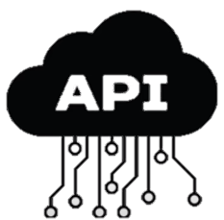
APIs
Definition:
API ➔ Application Programming Interface.
An API is a set of rules and protocols that allows different software applications to communicate with each other.
It enables developers to access and use the functionalities of another application, service, or platform.
Purpose of APIs:
Facilitate Integration, Expand Functionality, Enhance User Experience:
Types of APIs:
Web APIs, Library or Framework APIs, Operating System APIs
Common API Use Cases:
Social Media Integration, Payment Gateways, Mapping and Geolocation:
Notes:
APIs

Slide 4
PDF QUESTION & ANSWERING
Notes:
Main Project

Slide 5


Project Overview:
The PDF Question Answering System
Main Function ➔ Assist users in extracting relevant answers from PDF documents based on their questions.
GUI ➔ Input user questions,
load PDF files or folders,
Retrieve the most relevant answers from the documents.
Search the keywords/questions on internet via Search on Wikipedia & Search on Google buttons.
Notes:
Project Overview

Slide 6
Working
PDF Loading: load PDF files or folders containing multiple PDFs.
extracts text from the PDFs using the PyPDF2 library,
Text Pre-processing: pre-processing using natural language processing techniques from the NLTK library.
It tokenizes the text into sentences and words.
Question Answering: Users can input questions into the system.
The system matches questions with pre-processed sentences from PDF documents based on word overlap.
Notes:
Working of PDF Question and Answer

Slide 7
Summarize PDF Function: Extracts text from a PDF file and generates a summary using a summarizer object.
Error Handling: Error handling displays appropriate messages if exceptions occur.
GUI: tkinter library enables easy file selection, question input, answer display, result clearing, text to voice, summarize pdf, search on Wikipedia, search on Google.
Additional Modules: Import necessary modules like messagebox to handle additional exceptions specific to your use case.
Notes:
Working of PDF Question and Answer

Slide 8
{ CASE STUDY }
SAP
{Systems, Applications, and Products}
Notes:
SAP Case Study

Slide 9

SAP Overview
SAP ➔ Systems, Applications, and Products
support various business functions.
streamline operations, improve efficiency, and drive growth.
The software provides integrated functionalities for seamless information flow across departments.
Key modules include:-
FI/CO , SD , MM , HCM , PP , CRM , and more.
SAP is widely used by organizations worldwide to optimize their business processes and achieve operational excellence.
Notes:
SAP Overview

Slide 10
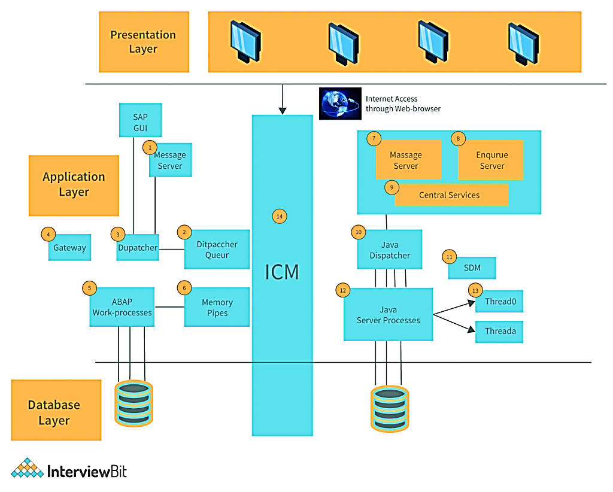
SAP Architecture Components
Notes:
SAP Architecture Components

Slide 11

Why Can’t We Use LLM API’s For Free
Dependency on Internet Connection
Privacy and Security Concerns
Lack of Control Over Model Updates
Cost and Pricing Structure
Limited Customization
Reliance on Third-Party Providers
Notes:
Why Can’t We Use LLM API’s For Free

Slide 12
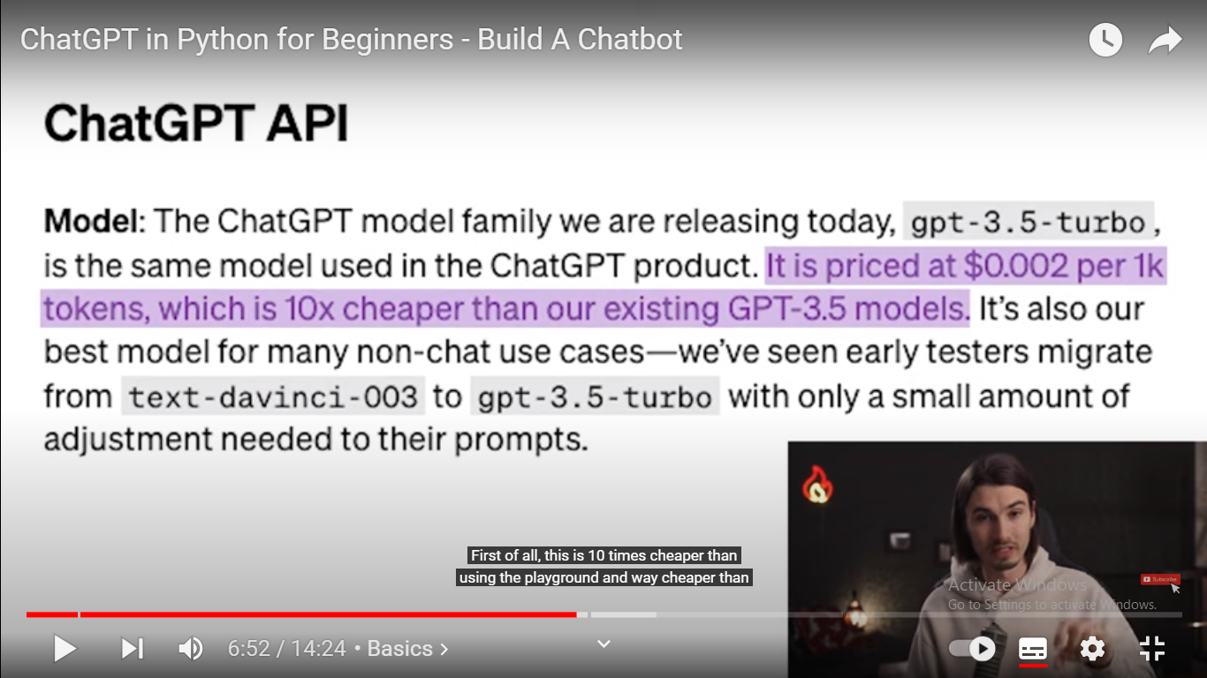
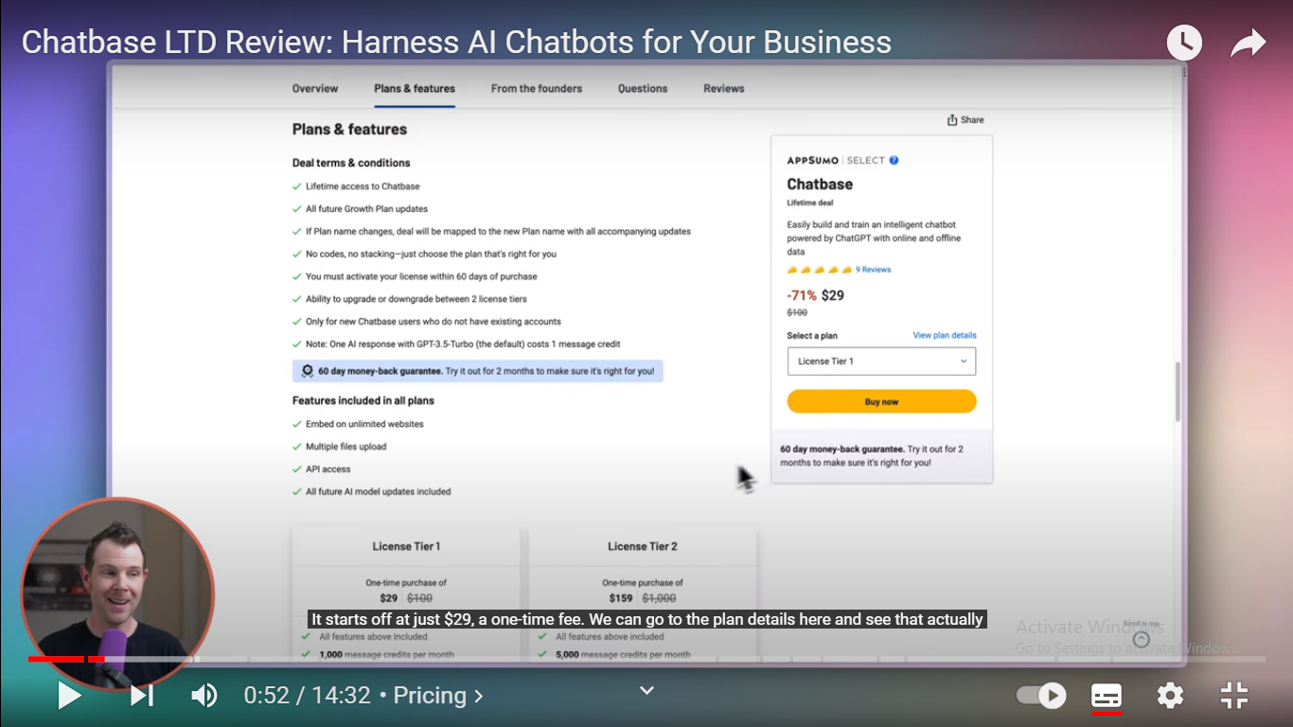
OpenAI API
Dialogflow API
Wit.ai API
The Amazon CodeWhisperer
RapidAPI Marketplace
Notes:
Reference / Proof

Slide 13
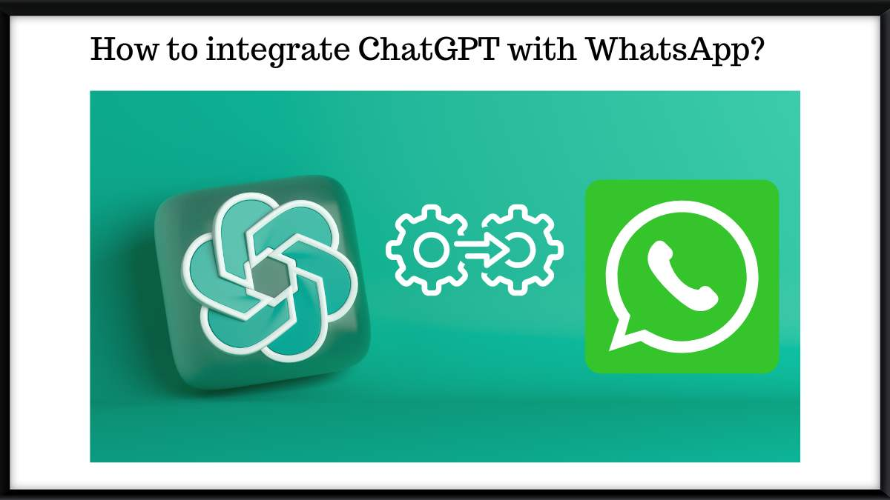
Integrating ChatGPT with your Whatsapp
Visit :- https://www.askjinni.ai/
Launch Whatsapp
Continue to chat
Whatsapp will open
first 11 to 15 iterations are free
https://www.whatgpt.ai/
https://mobile-gpt.io/
https://shmooz.ai/
https://buddygpt.ai/
Notes:
Integrating ChatGPT with your Whatsapp

Slide 14

CONCLUSION
In conclusion, during this internship I studies about:
NLTK, PyPDF2, Library in Python
APIs and its advantages and disadvantages
Integrate projects with LLMs (GPT-3.5, GPT-4, amazon codewhisperer)
SAP and its architecture
Project:
The PDF Question Answering System using NLTK, PyPDF2, APIs, Tkinters and Pre-trained models
Notes:
CONCLUSION

